Slide 1


Risk Management for Projects
Said Fawzy
Section 3:
Risk assessment

Slide 2
Module Contents
Why risk assessment?
The risk register
Likelihood and consequence
The risk assessment matrix
Qualitative and quantitative risk analysis
Summary
Discussion: Risk assessment approach
FAQs

Slide 3
1 Why risk assessment?

Slide 4
What you will learn in this section
In this section, you will learn how to:
Recognize the process of undertaking a risk assessment of identified risks
Select risk controls through risk assessment
Use a risk matrix to respond to identified risks
Clarify risks to stakeholders, and
Use contingencies to deal with risk.

Slide 5

The Risk Assessment Canvas
The quality of your risk assessment work will be dependent on the input from the previous two stages.
If you haven't set proper objectives and identified the range of possible risks, then your risk assessment is likely to be of limited value.
the lesson here is not to rush through the process, but to spend the time in the initial stages to make your risk management process a robust one

Slide 6


two key dimensions for each of your identified risks:
the likelihood or possibility of the risk occurring.
the consequence or impact may be on you achieving your project objectives
A common tool used for this type of qualitative risk assessment is the risk assessment matrix.

Slide 7
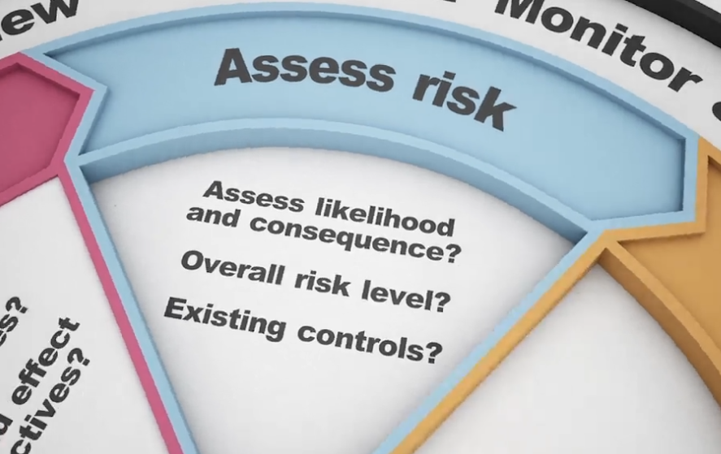
Key questions in the assessment stage
How will you assess both likelihood and consequence of each identified risk?
How will you determine the overall risk level, and are there any controls already in place, and if so, how effective are they?

Slide 8
2 The risk register

Slide 9
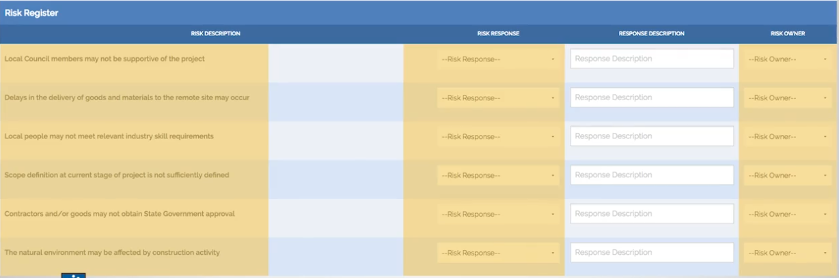
The risk register (the risk log).
It is a formal master document that records all your risk management work, such as :
identified risks,
their likely consequence or impact, and
any steps that need to be taken to respond to the risks.

Slide 10


The risk register (the risk log).
The most effective way to record and present risk register information is as :
Table
Spreadsheet
Database

Slide 11

The risk register (the risk log).
As a project or risk manager, you should view the risk register as the key management tool for you and your team to manage your project risks.

Slide 12
The risk register follows the stages of the risk management process
Example:

Slide 13
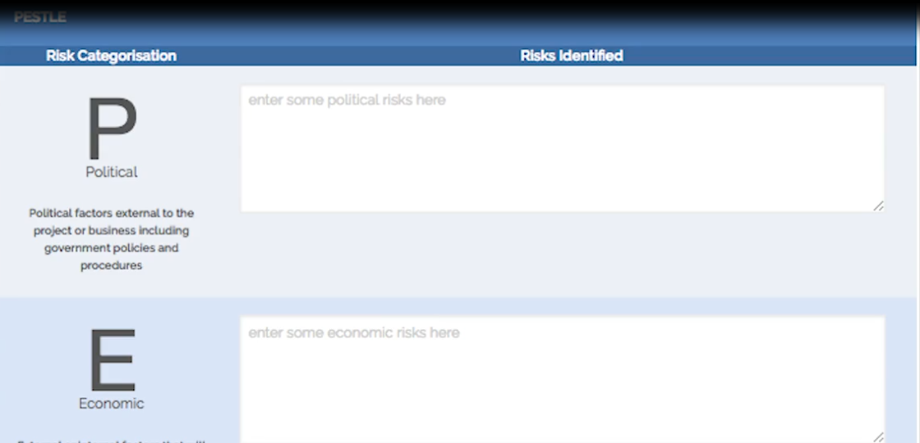
By doing the Section 2 activities, you started by clarifying your project objectives, and then you identified the risk for your project, using a PESTLE-type template.
Once you have this information, you can enter these risks in your risk register by:.
describing the risk
and assigning a PESTLE risk category

Slide 14
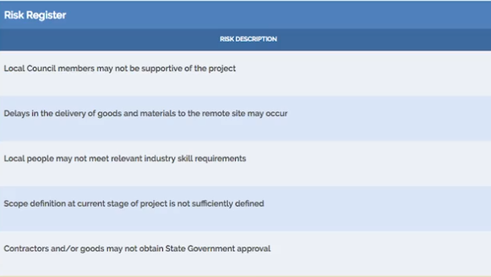
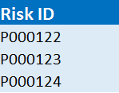
It's also advised that each risk is given a unique identification number, so that the risk can be assigned and tracked throughout the project.

Slide 15
The next component that needs to be added to the risk register is the analysis and the assessment that you will make in relation to each recorded risk.

Slide 16
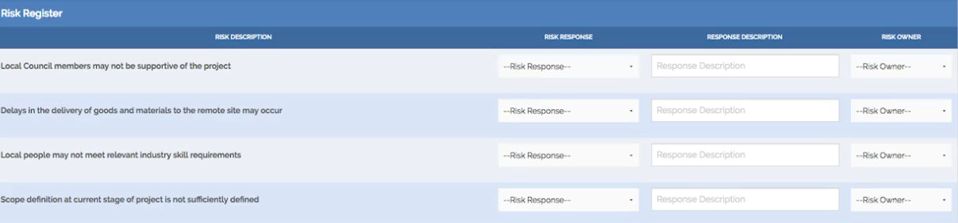
The remaining elements of the risk register will contain information relating to your specific risk response to the assessed risks, together with a nomination of who has been assigned ownership and responsibility to manage that specific risk.
response
who
Response
Response Description
Risk Owner
A well-designed and robust risk register serves as a core project management tool

Slide 17
Complete the risk register: Part 1
IDENTIFY THE CAUSE, EFFECT AND PHASE
This is the 1st of 3 stages of the risk register. You will be considering 6 of the risks which were identified in the Western Savannah case study in Section 2 of the course. For each risk, select the:
Cause
Effect, and
Phase of the project affected by the risk.
revisit the content of the Western Savannah case study .

Slide 18
Complete the risk register: Part 1
GO TO FILE
Complete the risk register_ Part 1 _ The risk register _ RiskX Courseware _ edX.HTML

Slide 19
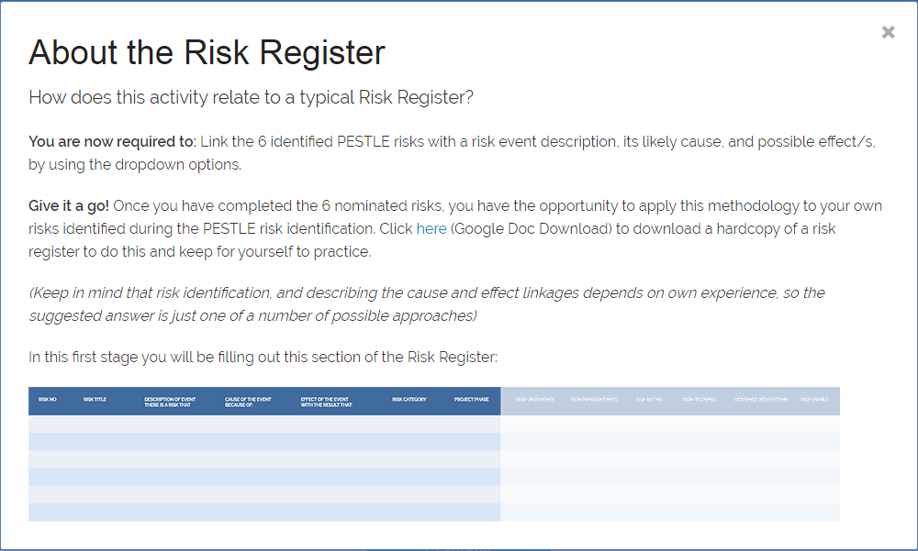
Use the example Excel of

Slide 20
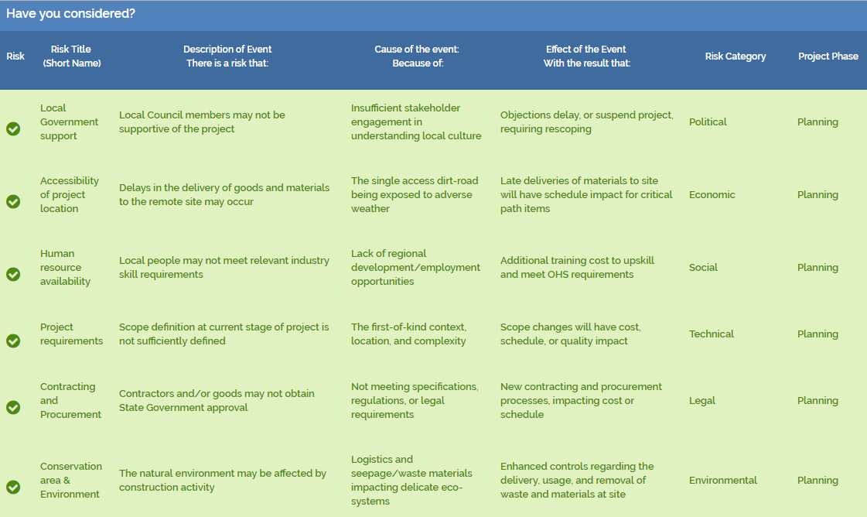

Slide 21
Tips and Traps to consider
Now that you have worked through the process of identifying risks and considering the links between the event, cause and effect of each risk, there are a couple of points for you to consider and be aware of when undertaking this part of the risk management process:
The description of the risk should be succinct and make sense to you and your project team.
Making the link between the cause and effect is an important part of the overall risk identification process. The link between cause and effect clarifies the specific area that requires a specific risk response.

Slide 22
3 Likelihood
and consequence

Slide 23
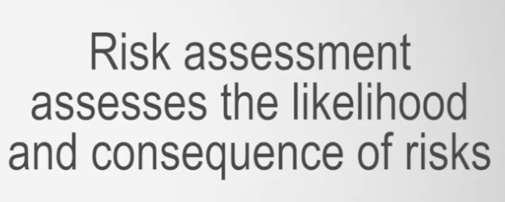
Likelihood and consequence
The aim of the risk assessment stage of the process is to gain an understanding of the nature of each risk and to determine the level of risk that you are going to assign to it.
So what do we mean by likelihood and consequence of risk?

Slide 24

Likelihood

Slide 25

Consequences
Set the likelihood consideration aside for the moment and try to imagine what would happen should the risk actually trigger.

Slide 26

Example:
A commercial airline company would want to ensure the safety of customers and crew on all operating flights.

Slide 27




Through a risk identification process, two major risks can easily be identified for each flight:

Slide 28
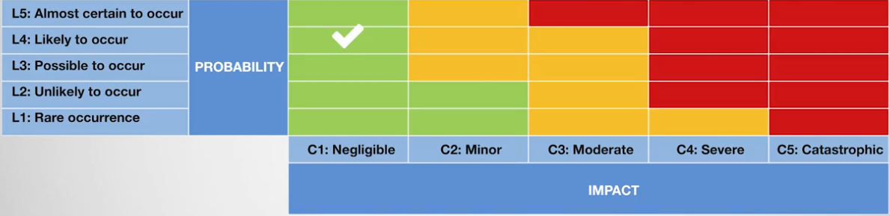
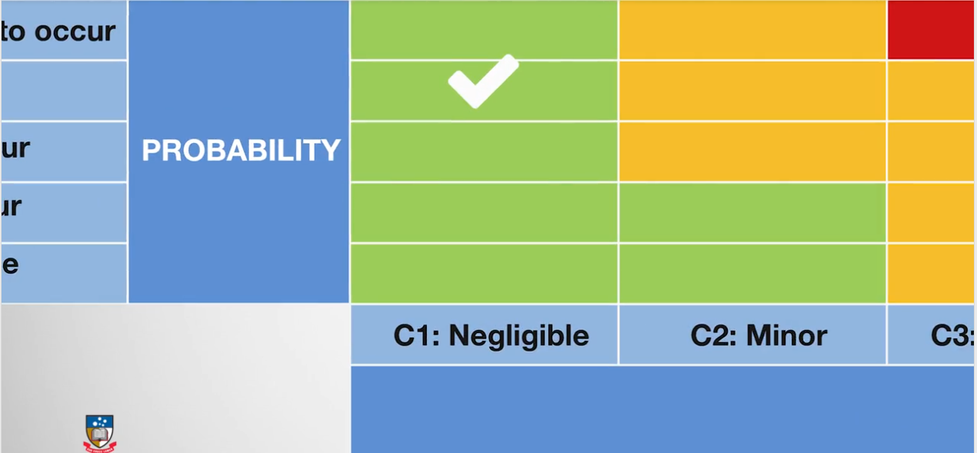
The risk of the plane being late for departure may be deemed to be likely to occur
the consequences may be deemed to be quite small.
hence a lower risk level.

Slide 29
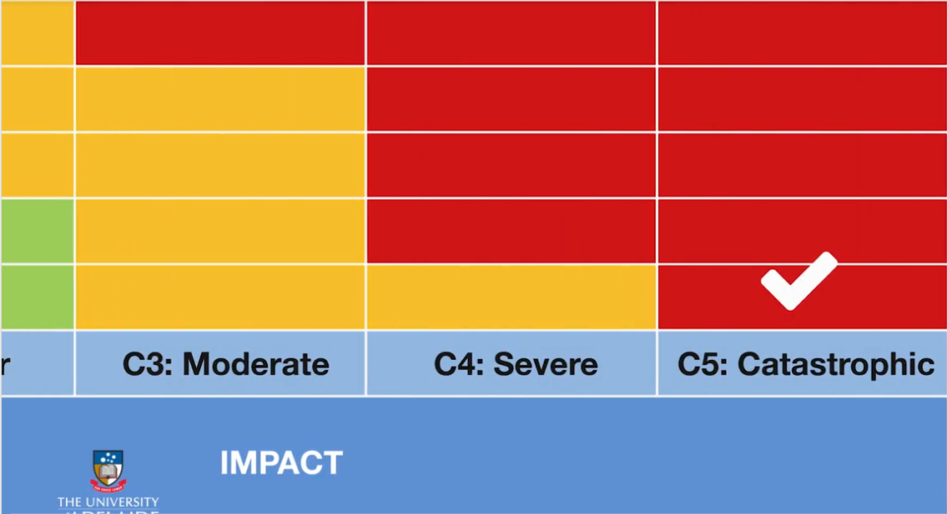

Even though the risk of a plane crash may be deemed as low likelihood of occurrence,
we would anticipate catastrophic consequences should it occur.
Hence, this would be assessed at a higher risk level.

Slide 30
So clearly, both risks would end up with different risk levels attached.
This is important for decision-making purposes.
High
Low

Slide 31
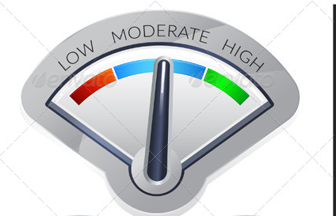
Likelihood :
Seeking to gain insights into the chances or likelihood of each identified risk occurring.
By this, we mean a low, moderate, or high chance of occurrence

Slide 32



Consequences
Once you have considered the likelihood, then you need to put this aside and make a bold assumption that the risk has actually occurred.
Then your focus is in trying to anticipate the possible consequences to your project objectives as a result of its occurrence.

Slide 33
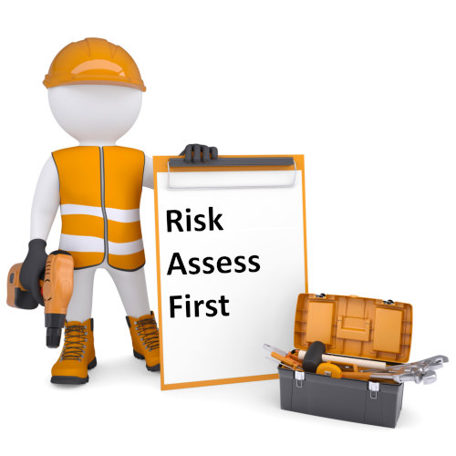
. So when assessing your risks, you are considering...

Slide 34
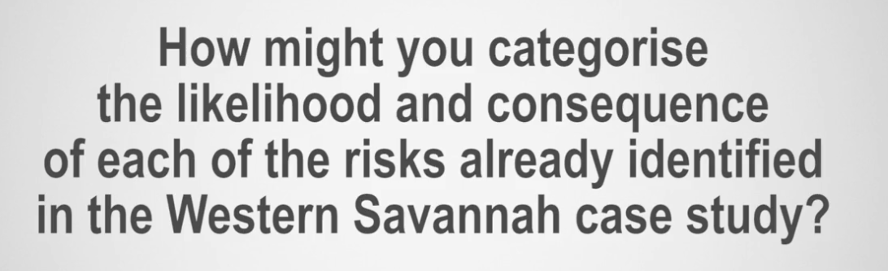

Think about the Western Savannah case

Slide 35
Knowledge check 1:

Slide 36

Question 1
Which of the following definitions most accurately describes risk management?
It is the process of researching, reviewing and acting upon
It is the process of reviewing, monitoring and managing
It is the process of analyzing, changing and avoiding
It is the process of identifying, assessing and responding to
Explanation
Typically, risk management follows a process, which is identifying the risk, assessing its likelihood and impact, and then responding to it. The project manager, in collaboration with other stakeholders, will decide on how to deal with the identified risk.

Slide 37
Question 2
What information can you gather through risk assessment?
The person who will detect the risk event
The Likelihood and consequences of Risk
How easy or difficult it will be to detect the risk event
When the risk event will occur
All of the above
Explanation
A risk assessment carefully considers the likelihood of the risk, or the probability of the risk event, taking place. Risk assessment also takes into consideration the impact that the risk may have on the project.

Slide 38
Question 3
What is the main objective of risk management?
To avoid every project risk
To determine responses to identified risks
To increase the likelihood and impact of positive events, and decrease the likelihood and impact of negative events
To identify every project risk, and then shift the identified risks to business competitors

Slide 39
4 The risk
assessment matrix

Slide 40
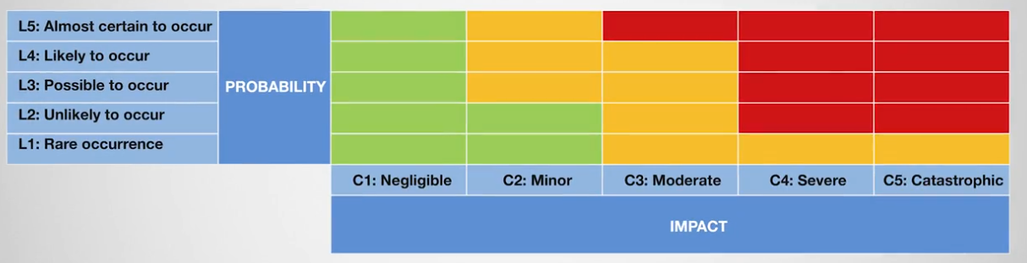
The risk assessment matrix
The risk assessment matrix provides a visual representation of the likelihood and consequence of each risk presented in the form of a table.
Enables a qualitative determination of risk on a rating scale of high, medium, or low.

Slide 41
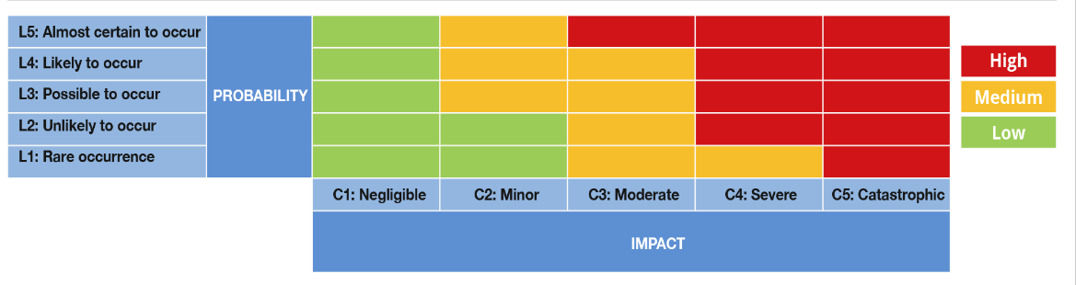

Slide 42
The risk assessment matrix:

Slide 43
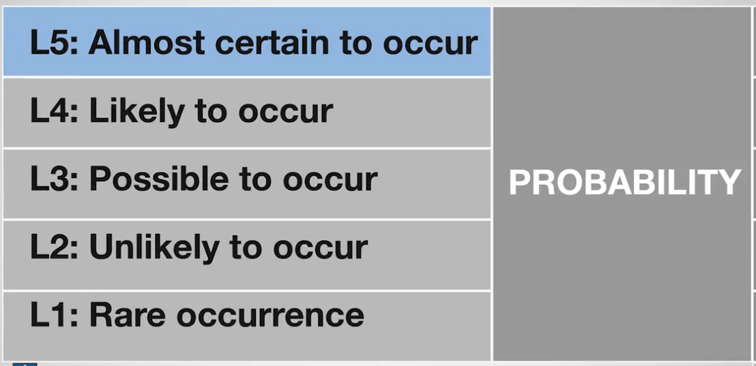
Likelihood component
(high probability)

Slide 44
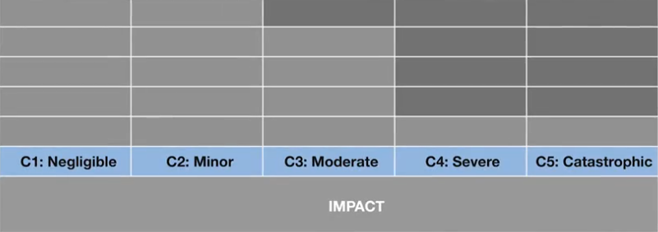
Impact:
very little impact or consequence
the risk or event can be easily remedied
some objectives may be affected, but with some effort, they can still be achieved
most of the objectives are effected with at least one severely affected.
resulting in few, if any, of the project objectives being reached.
or
where fatalities are possible

Slide 45

Example: the airline company

Slide 46
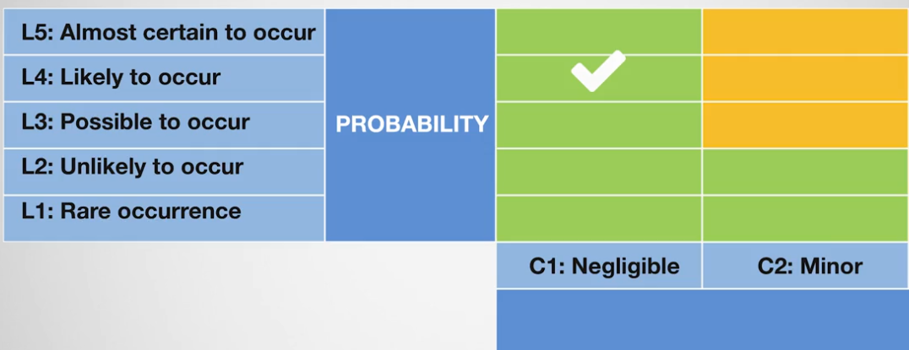

Slide 47
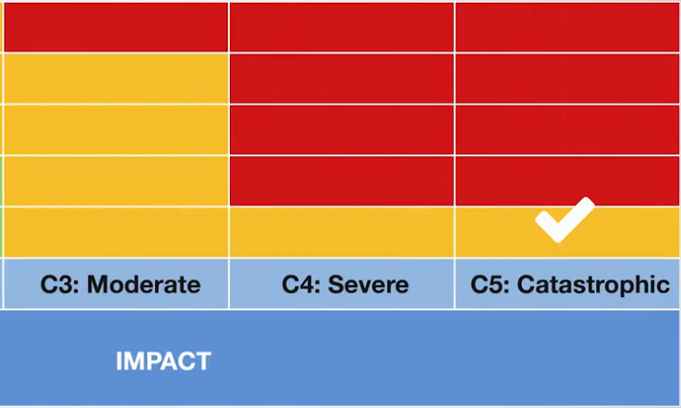

Slide 48
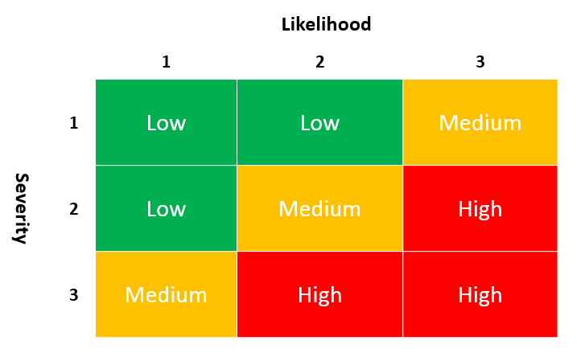
Ratings of your identified risks
Once you have determined the likelihood and consequence, and applied the events to your risk matrix, you will have a clear indication of the ratings of your identified risks as either high, medium, or low.

Slide 49
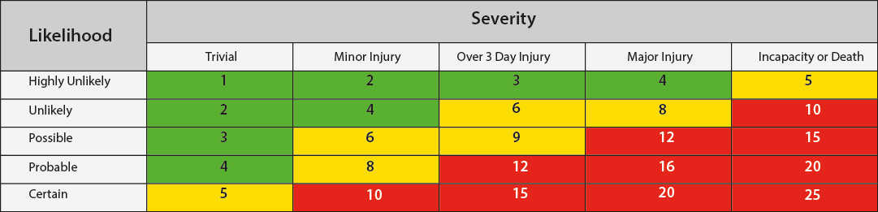
Example:

Slide 50
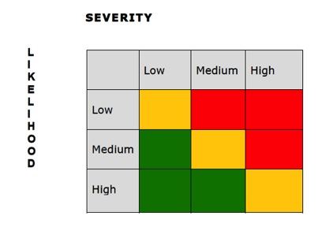
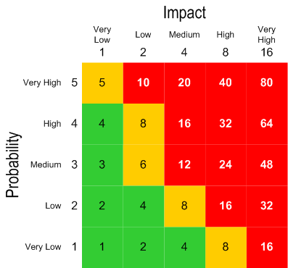
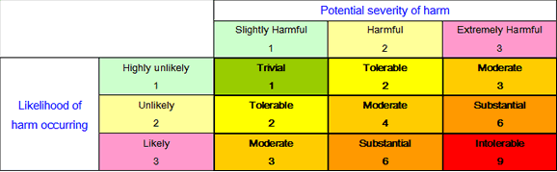

Slide 51
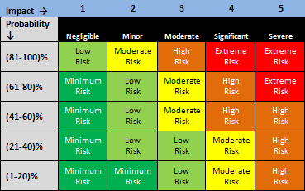
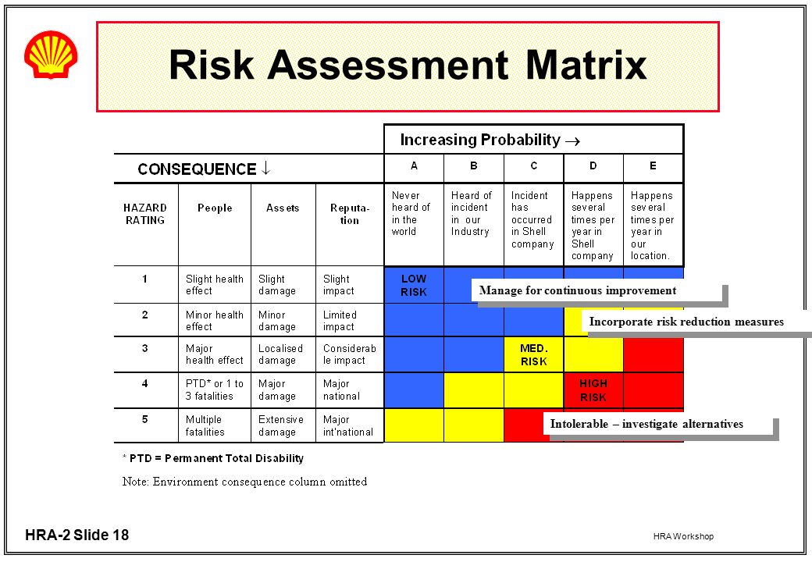

Slide 52
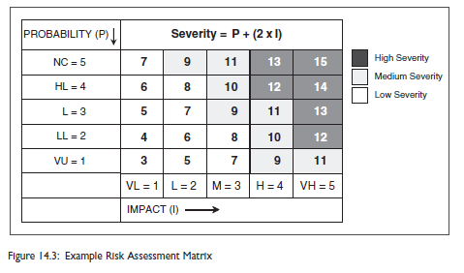

Slide 53
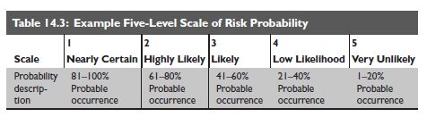
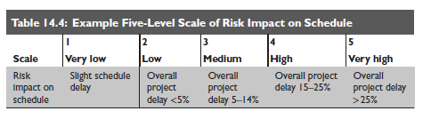

Slide 54
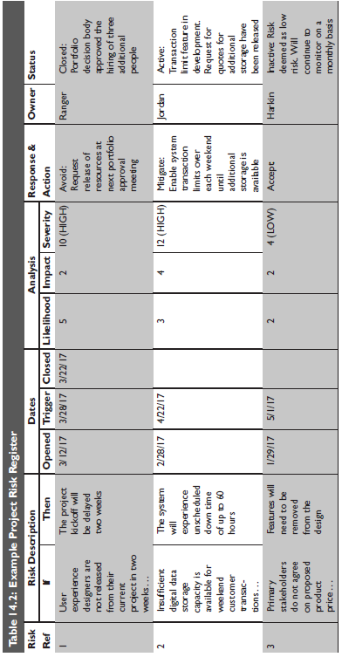

Slide 55
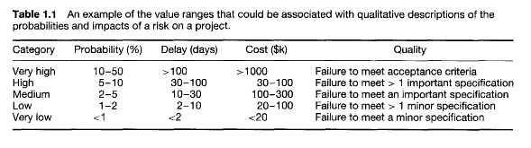

Slide 56
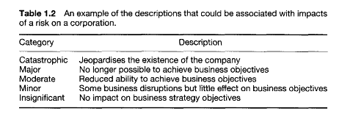

Slide 57
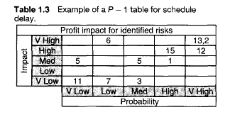

Slide 59
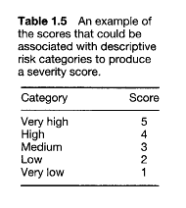
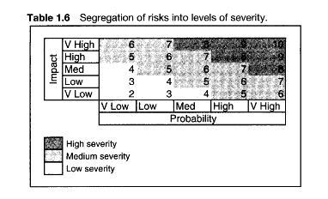

Slide 60
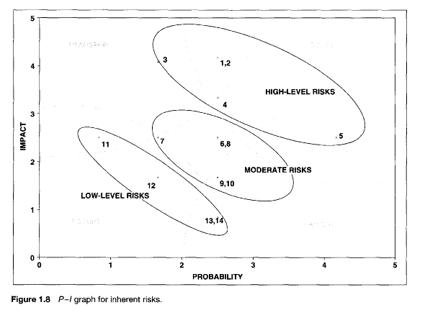
Transfer
Avoid
Accept
Control

Slide 61
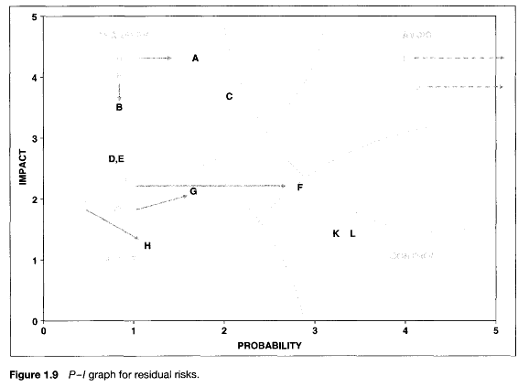
Transfer
Avoid
Control
Accept

Slide 62
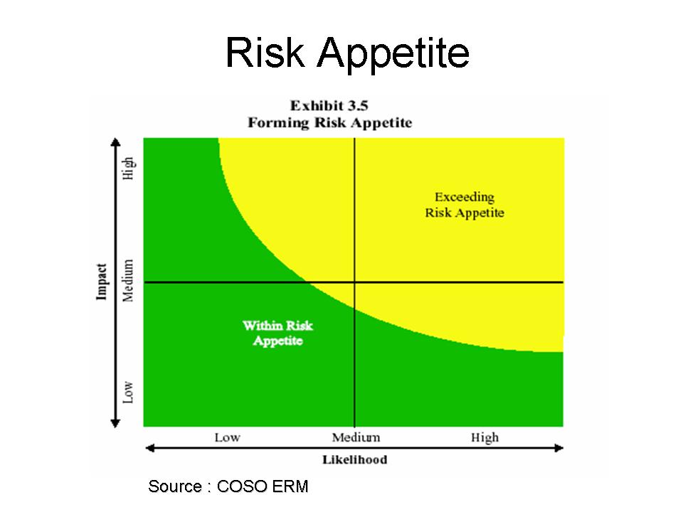
Risk Appetite (Risk Tolerance )
When considering your project, what risk are you prepared to accept as part of the project?
Your next step is to determine what level of risks you are willing to accept in your project.
This is known as the risk appetite, or risk tolerance, of the project or organization.

Slide 63

ALARP principle :
A widely used principle for determining criteria for acceptable risks

Slide 64



The ALARP principle recognizes that there are three broad categories of risks:

Slide 65
Quantitative risk assessment:
Quantitative risk assessment
Numerically analyzes the probability of each risk, its consequences on project objectives
It can be used separately or together with qualitative assessment.

Slide 66
How to ?
Quantitative risk assessment
For each of the identified risks, you need to quantify the probability of occurrence by asking:
“What is the probability that this risk will happen?”
90 %
The next step is to determine the risk impact.
“What will happen if this risk occurs?”
schedule or cost
severity of the risk

Slide 67
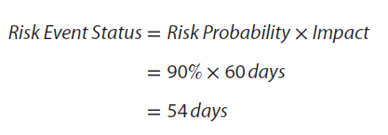
Example :
Quantitative risk assessment
if the highest priority project objective is schedule, then the risk event status would be calculated in terms of time.

Slide 68
Which risks are really vital and deserve attention and which are trivial?
Quantitative risk assessment
First, establish numerical intervals of severity that determine whether a risk event status is
critical (potential showstoppers),
near-critical (soon to be potential showstoppers), or
noncritical (minor risks).

Slide 69
Example :
Quantitative risk assessment
In small projects :
15 days was critical,
between 7 and 14 days near-critical, and
below 7 days noncritical.

Slide 70
Complete the risk register: Part 2
APPLY A RISK RATING
This is the 2nd of 3 stages of the risk register. You will be considering 6 of the risks which were identified in the Western Savannah case study in Section 2 of the course.
For each risk, refer to the Risk Matrix to identify the likelihood and consequence of each risk, which will determine the risk rating.

Slide 71
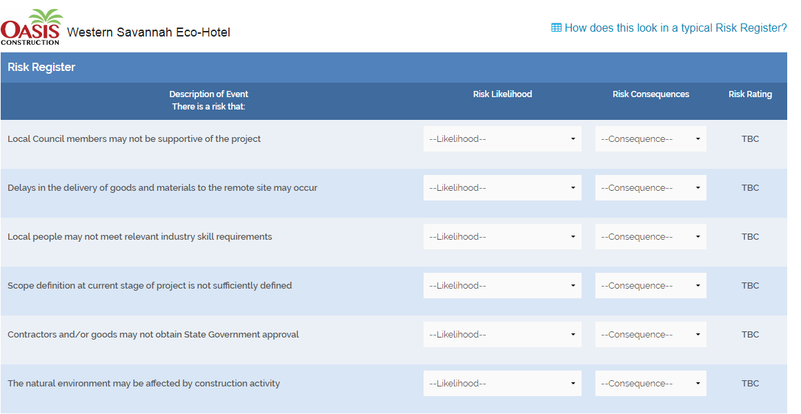

Slide 72
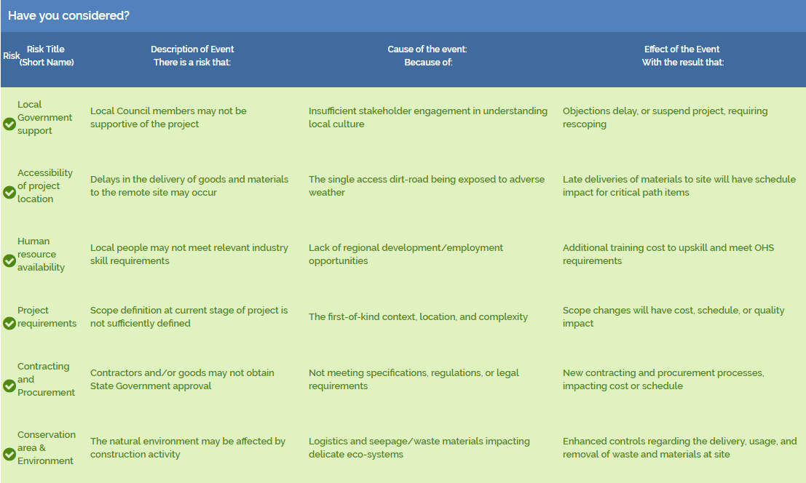
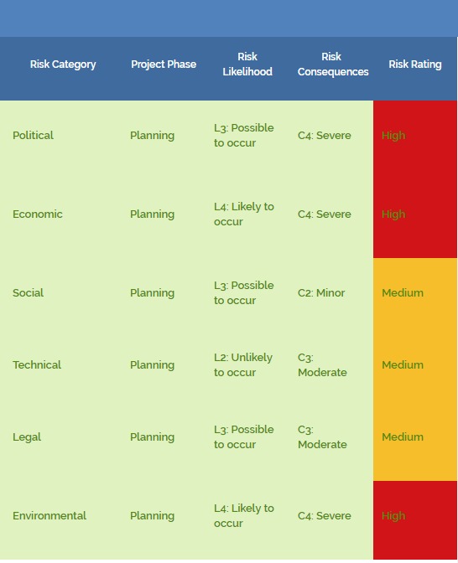

Slide 74
Tips and Traps to consider
Now that you have worked through the process of determining the likelihood and consequence of each risk, there are a couple of points for you to consider when you are undertaking this part of the risk management process:
Determine the likelihood and consequence of each risk, but be realistic. It is suggested to draw on the expertise and experiences of others to determine the appropriate level of assessment of the identified risks, if required.
As a visual, the risk matrix can provide an overview of the variation of likelihood and consequence of each risk, and determine priority risk responses. A warning sign for you should be when the risk matrix shows that all of the risks are high, or a combination of high or medium. In either of those cases, you will need to reconsider the project objectives, and carefully think about how you will respond to each risk.

Slide 75
5 Qualitative and
quantitative risk analysis

Slide 76
Gross risk vs residual risk

Slide 77

What is risk Residual ?
If, for example, certain controls or actions are already in place for some of the assessed risks in order to reduce or treat those risks.
then you would need to take this into consideration and determine what the revised level of risk is, hence the term residual risk or the risk that reminds or is left over

Slide 78

What is Gross Risk (Original Risk)
. If there are no controls in place and, therefore, the risk assessment is being done for the first time,
then you will be making decisions concerning the original or gross risk

Slide 79
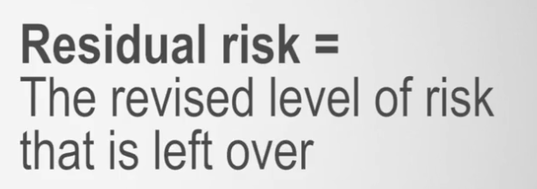
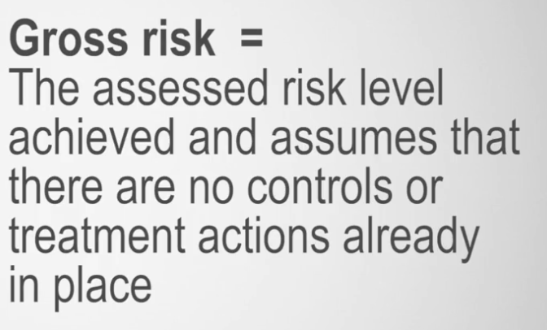
Gross risk vs residual risk

Slide 80


Example : Airline company
Assessment
High
Company put in place a proactive and highly effective maintenance regime
Residual Risk
the original risk
level is reduced
Medium

Slide 81
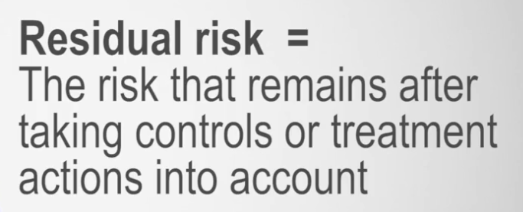
Residual risk:
If you determine that the residual risk is high, you may need to take extra measures.

Slide 82




Slide 83
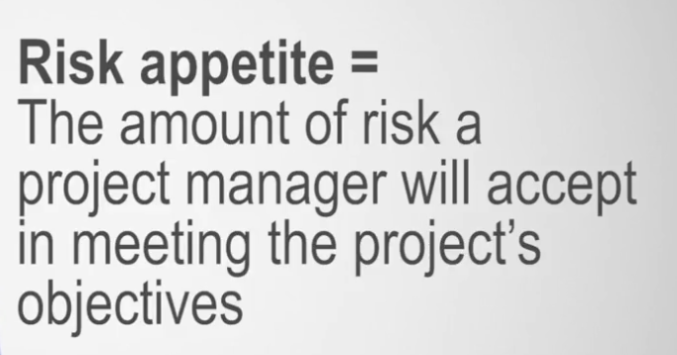

Slide 84

Example : Airline company
Residual Risk
High
You could consider the following questions:
Is there an effective maintenance regime in place?
Are all planes maintained in accordance with this regime?
Have the pilots and other crew had sufficient training?

Slide 85
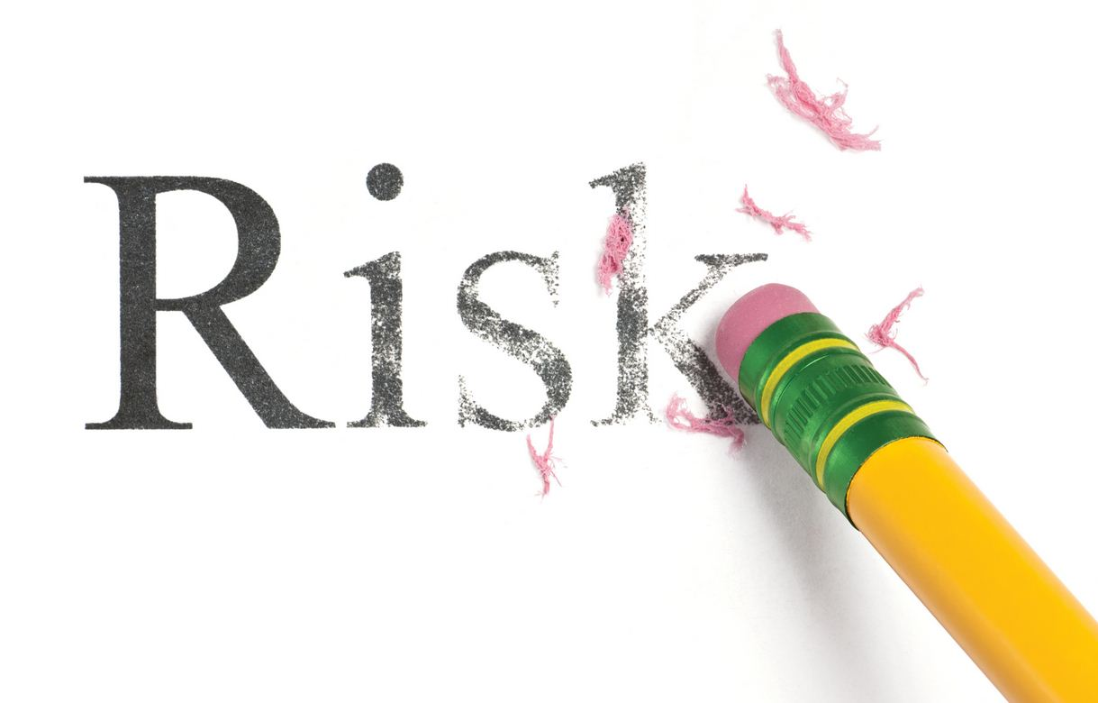
Remember, that the risk cannot be eliminated completely
controls are designed to treat or reduce the risk to an acceptable level.
We discussed this acceptable level before, and referred to it as the risk appetite,

Slide 86

Risk Appetite :
the amount of risk a project manager will accept in meeting the project's objectives.
the project manager should ensure that the appetite aligns to the risk culture, purpose, vision, and values of the organization, and the environment in which the project is being undertaken.

Slide 87
Question:
So considering our Western Savannah case, for the risks that you have assessed, do you think that these would be gross or residual risks? What might you have to further consider before finalizing your risk assessment

Slide 88
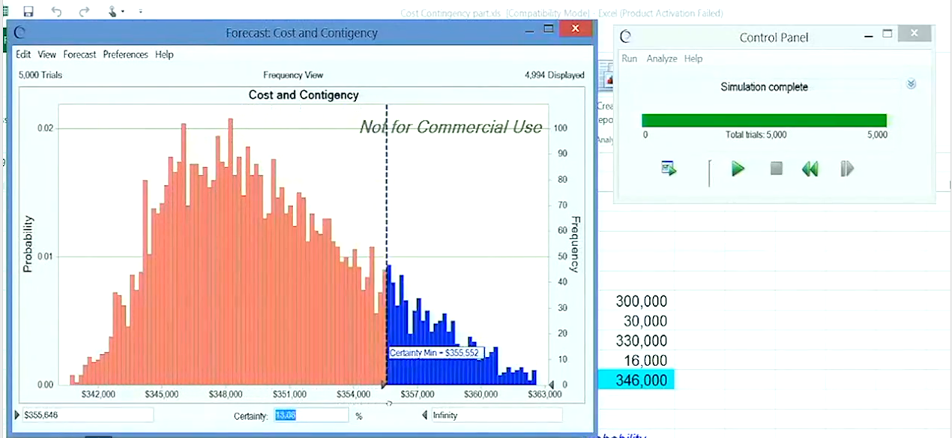
Monte Carlo statistical simulation

Slide 89


Risk Management Software:
from PALISADE (www.palisade.com)
From Intaver Institute (www.intaver.com) .

Slide 90
Monte Carlo Presentation

Slide 91
Knowledge check 2:

Slide 92
Question 4
Identifying a risk as "high", "moderate", or "low" would be an example of which risk assessment?
An adverse assessment
A qualitative assessment
A quantitative assessment
A go-for-broke assessment
Explanation
Using words to describe the risk level (rather than numbers) is deemed to be qualitative.

Slide 93
Question 5
A Monte Carlo simulation is an example of which type of risk assessment?
An adverse assessment
A qualitative assessment
A quantitative assessment
A go-for-broke assessment
Explanation
In this instance, a Monte Carlo simulation refers to a number, which is a quantitative assessment of a risk.

Slide 94
6 Summary

Slide 95
Bringing it all together
We began this section looking at the risk register .
The activities you have engaged with in Section 2 and Section 3 form part of the risk register.
The risk register begins with the identification of risks, and then categorizing those risks using an identification tool.
We use PESTLE
We then highlighted the importance of engaging your project team and stakeholders in formal meetings and brainstorming processes to ensure that all risks are properly identified and described

Slide 96
Cont.
Armed with robust information on the risks you identified, you are able to then assess those risks.
Determining the likelihood and consequences of each of those risks .
determine the overall risk level by using the risk assessment matrix .

Slide 97
Cont.
This is deemed to be a qualitative risk assessment.
Simply put, this enables your risk levels to be described as either high, medium, or low.
Quantitative risk assessment is the process of providing numerical or statistical estimates of the overall effect of risks on the project objectives when all risks are considered simultaneously.
Usually in terms of schedule and cost

Slide 98
Cont.
Remember, a risk assessment is one of the most important tasks in the successful delivery of a project small or large.
By now, everything is in place for you to consider how you might respond to the assessed risks in Section 4

Slide 99
7 Discussion:
Risk assessment approach

Slide 100
8 FAQ

Slide 101
FAQ:
How often do I do a risk assessment?

Slide 102
FAQ:
Why do I need to record a risk assessment?

Slide 103
FAQ:
Are there any documentation needs to be completed when identifying risks?

Slide 104
FAQ:
What is meant by developing risk criteria?

Slide 105
Feed back

Slide 106

Decision Tree :

Slide 107


Simple Example On Decision Tree:

Slide 108








Slide 109












The procedure for solving a tree is called “rolling back” or “folding back” the tree.

Slide 110



Slide 111
Financial Example on Decision Tree :

Slide 112





Slide 113






Slide 114





















